Slide 1
Welcome to CRPS Secretary’s Zoominar

Slide 2
Your Lodge is a Class D Member of the Canadian Royal Purple Not for Profit Society
Your LODGE - A Group of like-minded people who came together to carry out shared aims and objectives by forming a lodge and joining the CRPS as a Class D member
Your Lodge is a member of a Federally incorporated
Not For Profit Society and a Provincially incorporated Not For Profit
YOU ARE THE SECRETARY!

Slide 3
What does this mean?
Your Lodge has all the rights and privileges of a Not For Profit
Tax breaks
Gaming privileges
Governance model
Liability coverage for executive decisions
Operating under an umbrella of Not-For-Profit Legislation
AND….

Slide 4
AND
Our National Board, Constitution and our CRPS governance saves your lodge from having to deal with three levels of government reporting.
CRPS collects your reports as its promise and responsibility to the Federal and Provincial Not For Profit legislation requirements.
To ensure you are operating according to their requirements, the following information is required:
Holding an annual AGM
Maintaining audited (reviewed) financial records
Maintaining membership lists, approved minutes
Developing an annual budget
Operating under the Gaming legislation
Meeting regularly, following formal governance

Slide 5
Membership
You may have three levels of members (shareholders) in your not-for-profit lodge:
Class A – this is the base membership – voting
Class B – a Past National President - voting
Class E – a non-voting lifetime member
There is an application form for each of these classes.

Slide 6
Class A Membership Form

Slide 7
Class B Membership Form

Slide 8
Class E Membership Form

Slide 9
In Your Secretary’s Binder
1. Membership Forms
2. Minutes
3. Years of Service Record
4. Secretary’s Guide
5. Copies of Filed Forms (may be maintained in your computer as well)

Slide 10
1. Membership Application Completed Forms
In your secretary’s binder:
Save the original copy of each member’s application
Since 2014 – We no longer use the member’s register and numbering system

Slide 11
2. Minutes
A record of:
Date of meeting
Those in attendance - members and visitors
Correspondence
Treasurer’s report
Approval of previous meeting(s) minutes
All motions made or consensus reached at each meeting – mover and seconder
Copy of or summary of all reports presented
Signed by the President once approved at the next meeting Should be kept for seven years

Slide 12
3. Years of Service Record
Keep a record of the years of service so service pins are awarded when earned:
5year, 10, 25, 40-year pins are available at a cost from the National Office
50 year and 60 year will be gifted by CRPS when you request them
A 70-year certificate will also be gifted by CRPS upon request

Slide 13
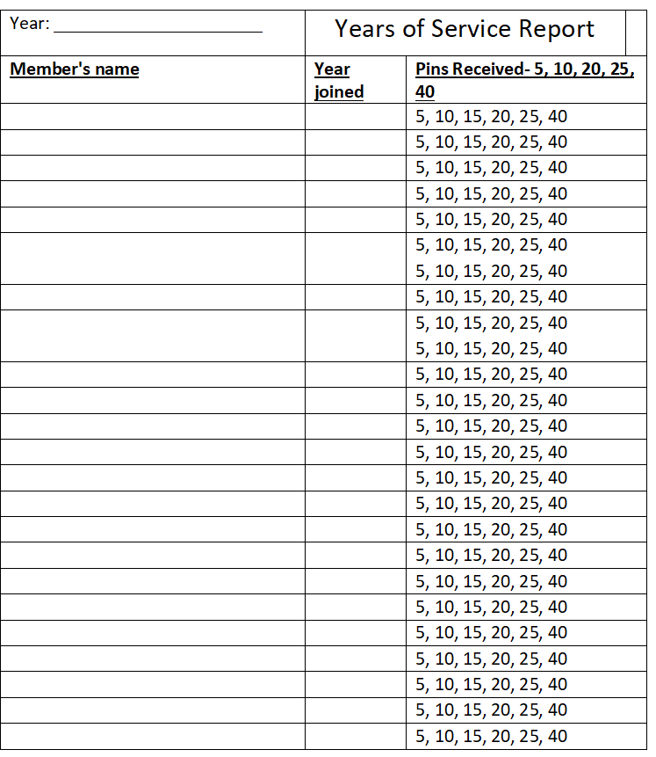
Years of Service Records example

Slide 14
4. Copies of Completed Forms
ANNUAL
President’s Annual Report Form
National Membership Report Form
Lodge Officer Report Form (Directory)
AS REQUIRED
Membership Change report Form
Deceased Member Form
Class A,B, and E membership Forms

Slide 15
Let’s Look at the Forms

Slide 16
In the Secretary’s Guide 1. National Membership Report Form
Due to National Office by Jan 15 – Each year
Name, class, address, email address, phone number
If they are Multi member- which is their home lodge
Amount submitted
Can be done in an Excel sheet or use the website fillable form or the paper form in your guide

Slide 17
2. Lodge Officer Report Form
File as soon as your election/AGM has been held – preferably in the spring

Slide 18
3. Directory Form
Available as a fillable form on the website and provides contact information for your lodge
Due May 15
Lodge President and secretary
Phone numbers and email
Meeting Date, Time and Place
Lodge mailing and emailing address

Slide 19
4. Membership Changes Report Form
A fillable form on the website
To be filed right after the change occurs – initiation, member transfers or leaves, death
Also, for change of address, phone number, email change

Slide 20
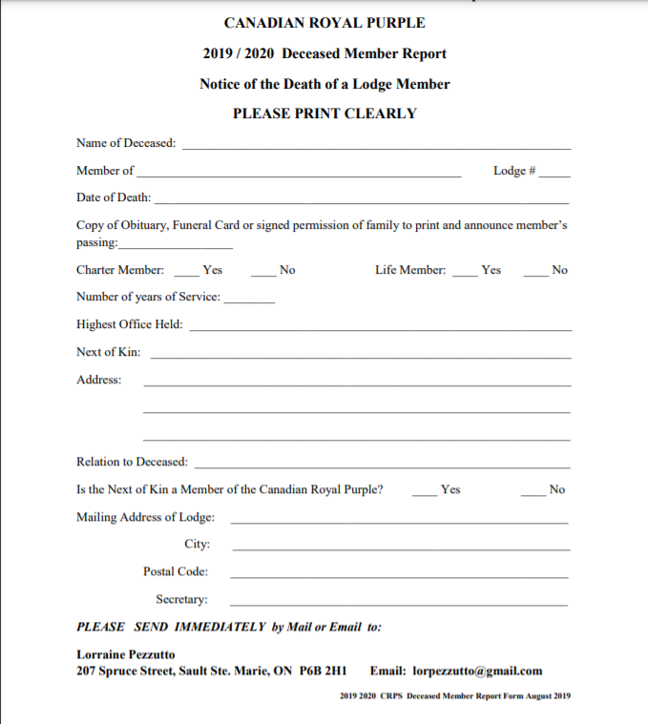
5. Deceased Member’s Form
Is available on the website as a fillable form
A funeral card, obituary or permission to list the member in our Memorial Book (FOIP) should accompany this form
Note: Refer to the Purple Book of Memories Form to further recognize the member.

Slide 21
Lodge President’s Report Form In the President’s Guide or Website:
Filling in this report may require your assistance.
A copy of the lodge budget and annual financial statement should be attached

Slide 22
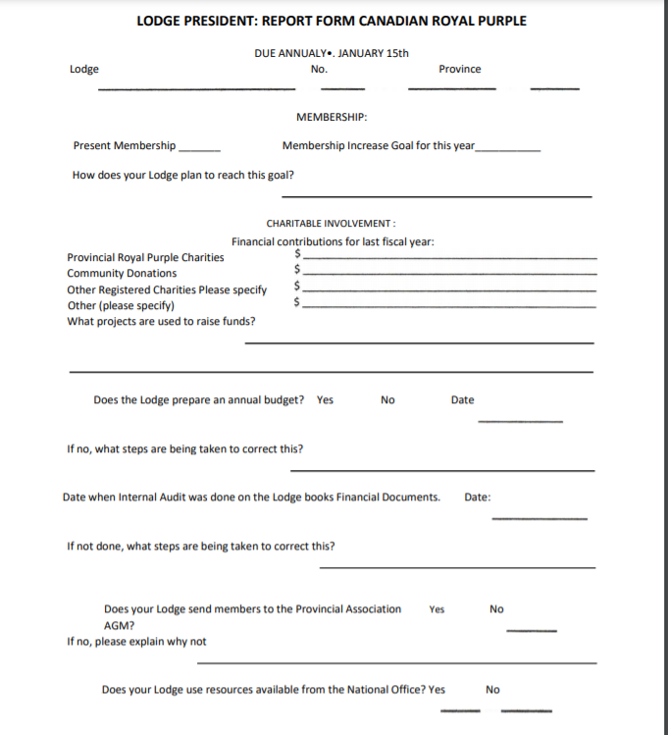
Lodge President’s Report Form

Slide 23
Missed a lane e us
You do not need to keep attendance records
Use the Member’s attendance book or a sign in sheet for attendance if needed

Slide 24
It’s tough to keep adapting to new ways
Not the wrong way –
the old, comfortable way

Slide 25
QUIZ TIME

Slide 26
Question 1: Your Royal Purple Lodge a Class ____ Member.
D
C
A
B

Slide 27
Question 2: When is the National Membership Report form due to National Office?
A) April 30th
B) July 1st
C) December 31st
D) January 15th

Slide 28
Question 3: How long should Secretary’s minutes be kept for?
A) 10 years
B) 7 years
C) Forever
D) 5 years

Slide 29
Question 4: Member Service Pins are awarded at….
A) 5, 15, 20, 25, 45 years
B) 5, 10, 20, 25, 40 years
C) 5, 10, 25, 40, 50 years
D) 5, 15, 20, 25, 45 years

Slide 30
Question 5: What should be included with the President’s Report to National Office?
A) List of Charities
B) Copy of the lodge budget
C) Annual financial statement
D) A copy of the lodge budget and annual financial statement
E) All of the above
A) List of Charities
B) Copy of the lodge budget
C) Annual financial statement
D) A copy of the lodge budget and annual financial statement
E) All of the above

Slide 31
Question 6: True or False? You need to keep Attendance Records.
A) TRUE
B) FALSE

Slide 32
Question 7: A changes in Membership Form must be completed when?
A) Initiation
B) Member transfers or leaves, a death
C) Change of address, phone number, email change
D) A and B
E) All of the Above

Slide 33
Question 8: Lodge Directory Form includes everything except________.
A) Lodge President and secretary names, and their phone numbers and email
B) Meeting Date, Time and Place
C) Members information
D) Lodge mailing and emailing address
E) All of the above is included

Slide 34
Question 9: Your lodge is a member of a ___________ incorporated Not For Profit Society and a _____________ incorporated Not For Profit
Answer: Your Lodge is a member of a Federally incorporated Not For Profit Society and a Provincially incorporated Not For Profit .

Slide 35
Question 10: What needs to accompany a Deceased Member Form to list a member in the Memory Book?
A) A funeral card
B) Obituary
C) Permission
D) Any of the above
E) Nothing, just the form is needed

Slide 36
Any comments, questions?

